Slide 1


ACT: Architectural Carbon Modeling Tools
@ MICRO 2024
Tutorial
Leo Han
Udit Gupta

Slide 2
ACT Tutorial: Today
Time | Topic
1:00 – 1:15pm | Introductory remarks
1:15 – 1:30pm | Sustainable Computing: Motivation and Challenges
1:30 – 2:15pm | Overview of ACT: An Architectural Carbon Modeling Tool
2:15 – 2:45pm | Hands-on ACT demo
2:45 – 3:00pm | Extending ACT
3:00 – 3:30pm | Break
3:30 – 4:30pm | Invited Talks: Tools for Carbon Accounting
4:30 – 5:00pm | Discussion
5:00 – 5:05pm | Closing Remarks
Notes:
Finally, given our understanding of carbon emissions, we will conclude by charting paths for how to design future sustainable computing systems.

Slide 3
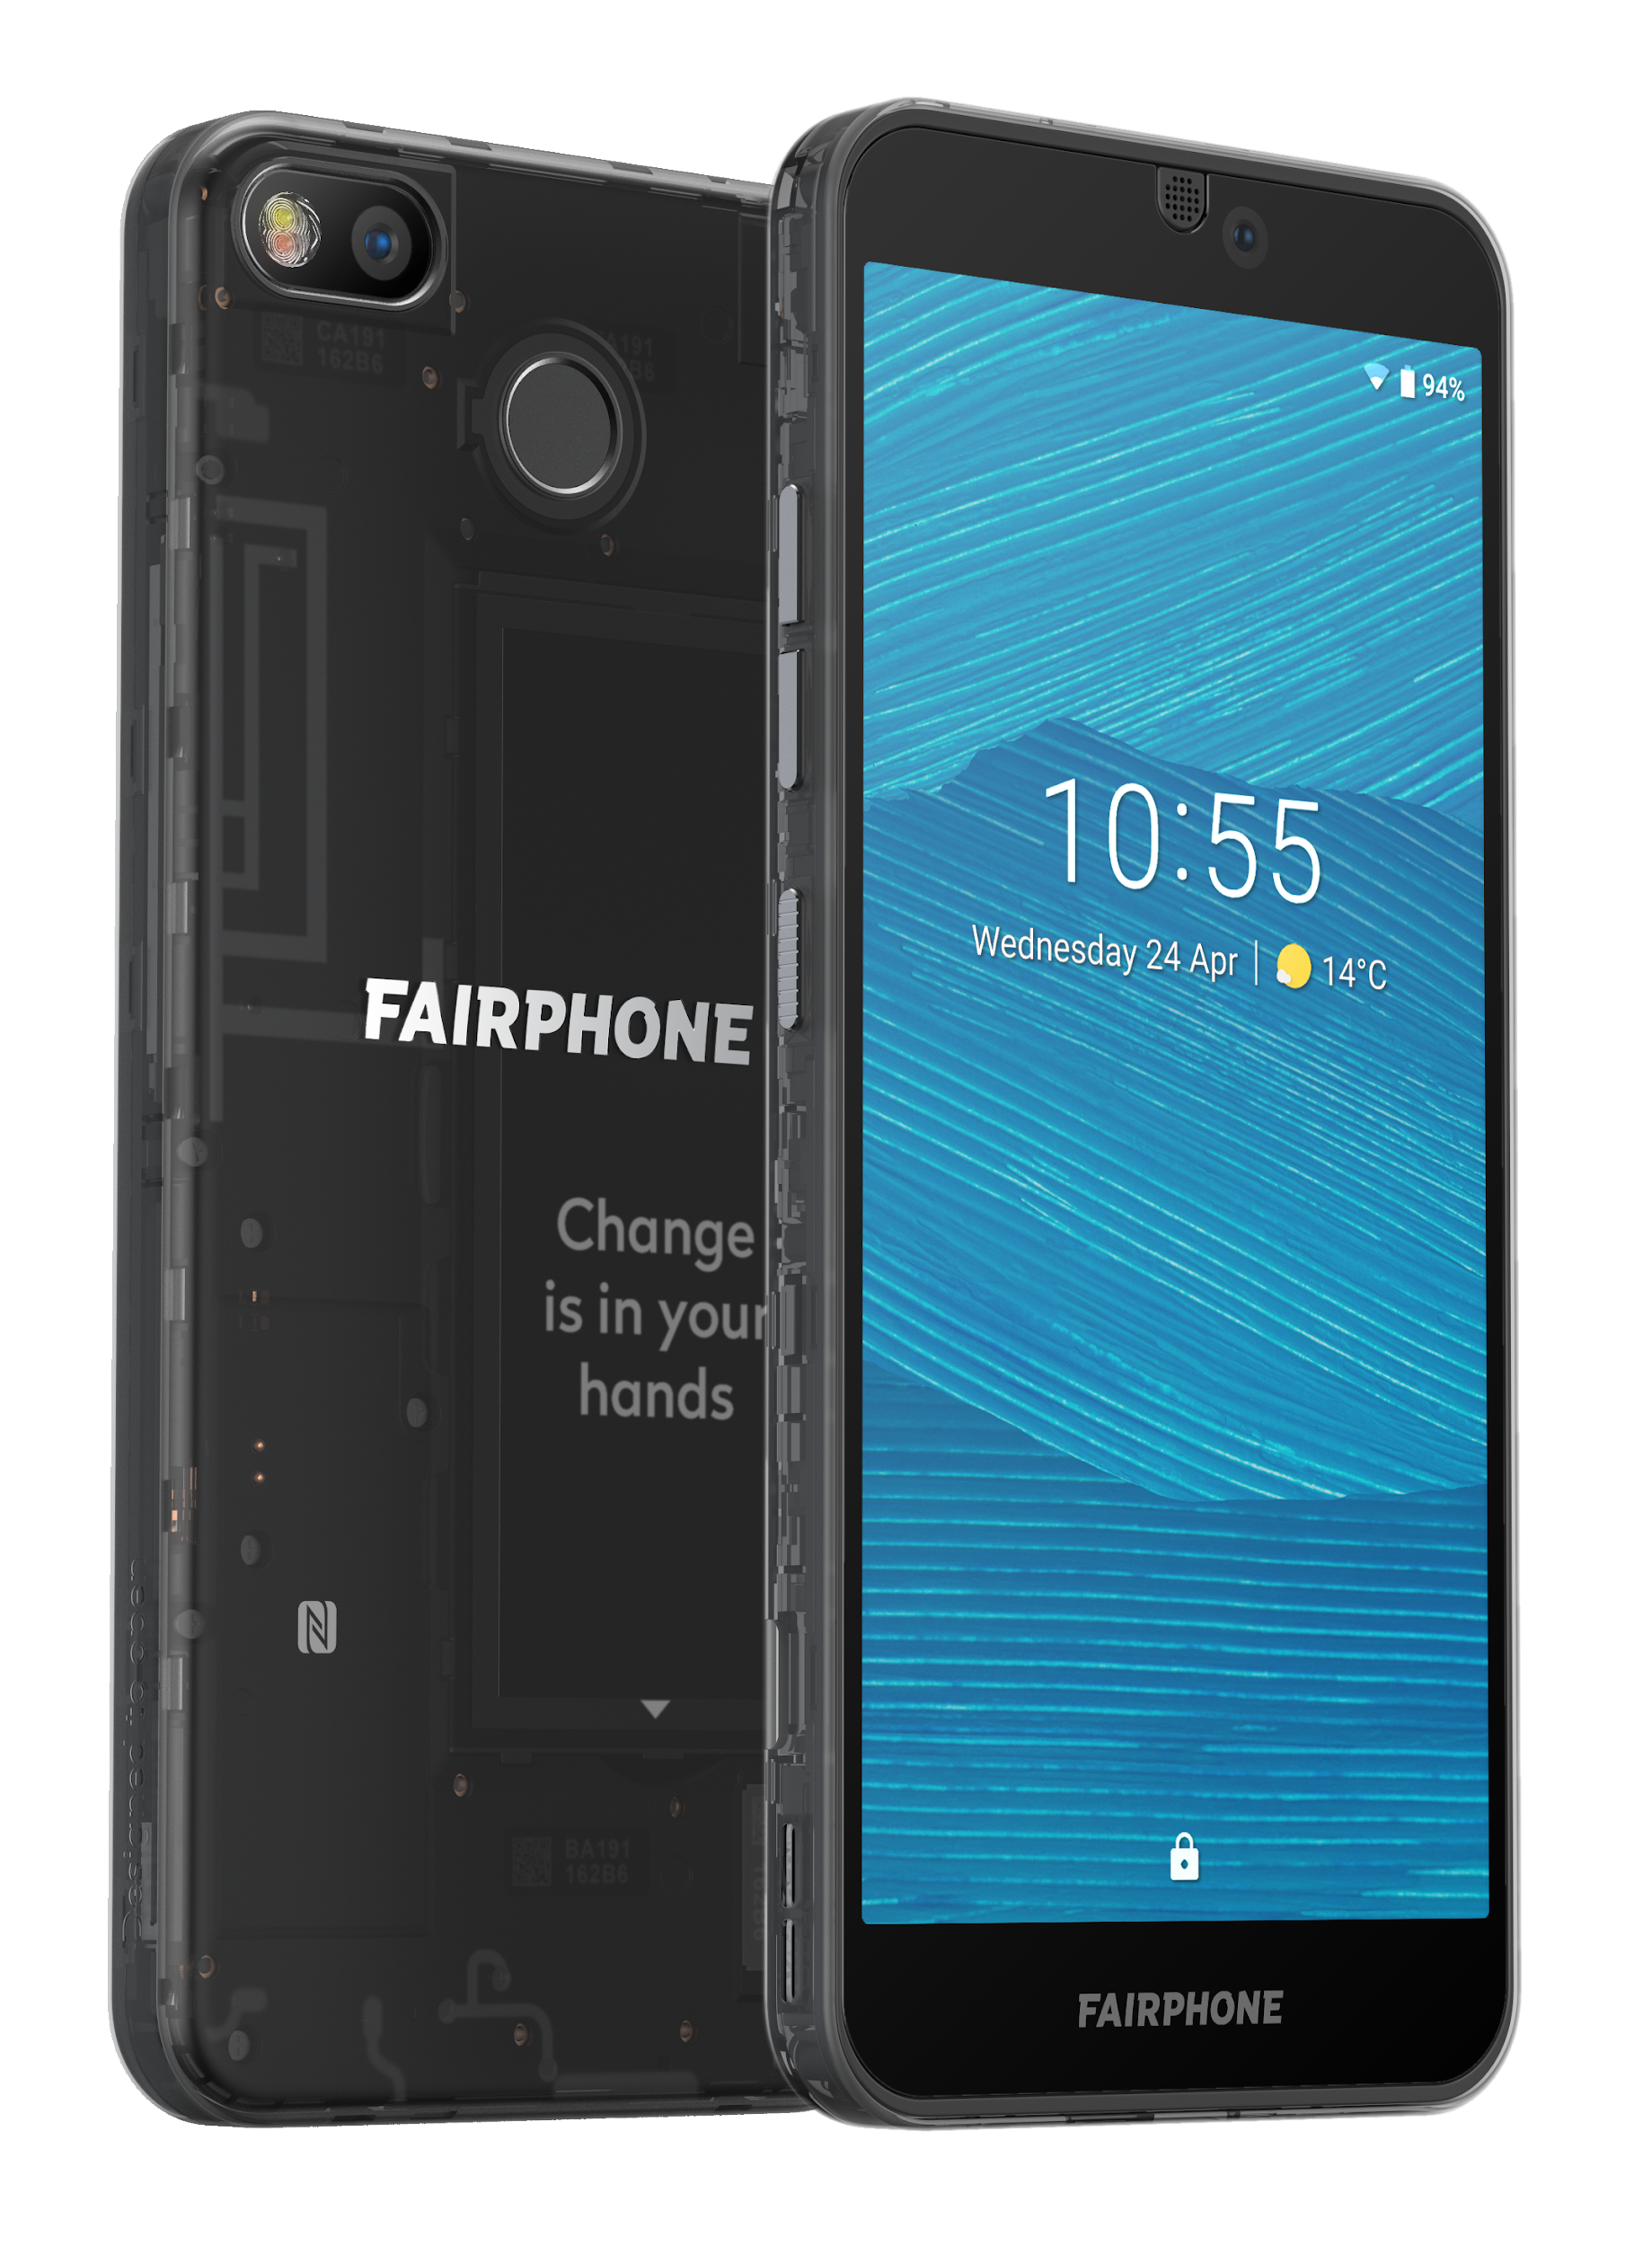
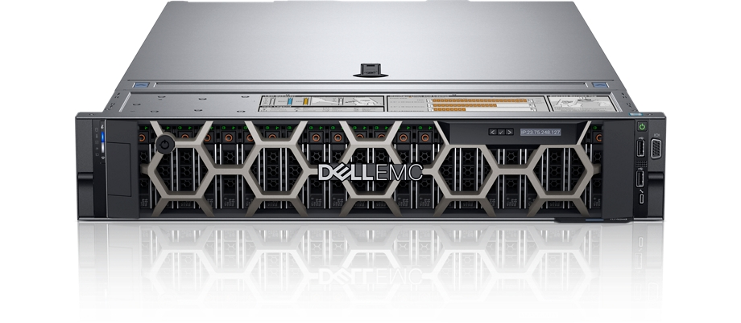
Estimating the embodied footprint of 2 devices using ACT
IC component | ACT vs. Dell R740 server LCA | ACT vs. Fairphone 3 mobile device LCA
Compute (processors, SoC’s) | Within 2.2x | Within 1.18x
Memory | Within 1.62x | Within 2.1x
Storage | Within 1.05-2.2x
Takeaways
ACT provides first-order approximation of LCAs that use old technology nodes (45nm NAND, 32nm CPU)
ACT enables architects to study new technology nodes

Slide 4

How to set up ACT
>$ git clone https://github.com/S4AI-CornellTech/ACT.git
>$ cd ACT/
>$ source setup.sh
>$ python3 model.py
https://github.com/S4AI-CornellTech/ACT.git
[Fab logic] Carbon/area from energy consumed 1209.5
[Fab logic] Carbon/area from gasses 240
[Fab logic] Carbon/area from materials 500
[Fab logic] Carbon/area aggregate 2228.0
Notes:
Note: Add units

Slide 5
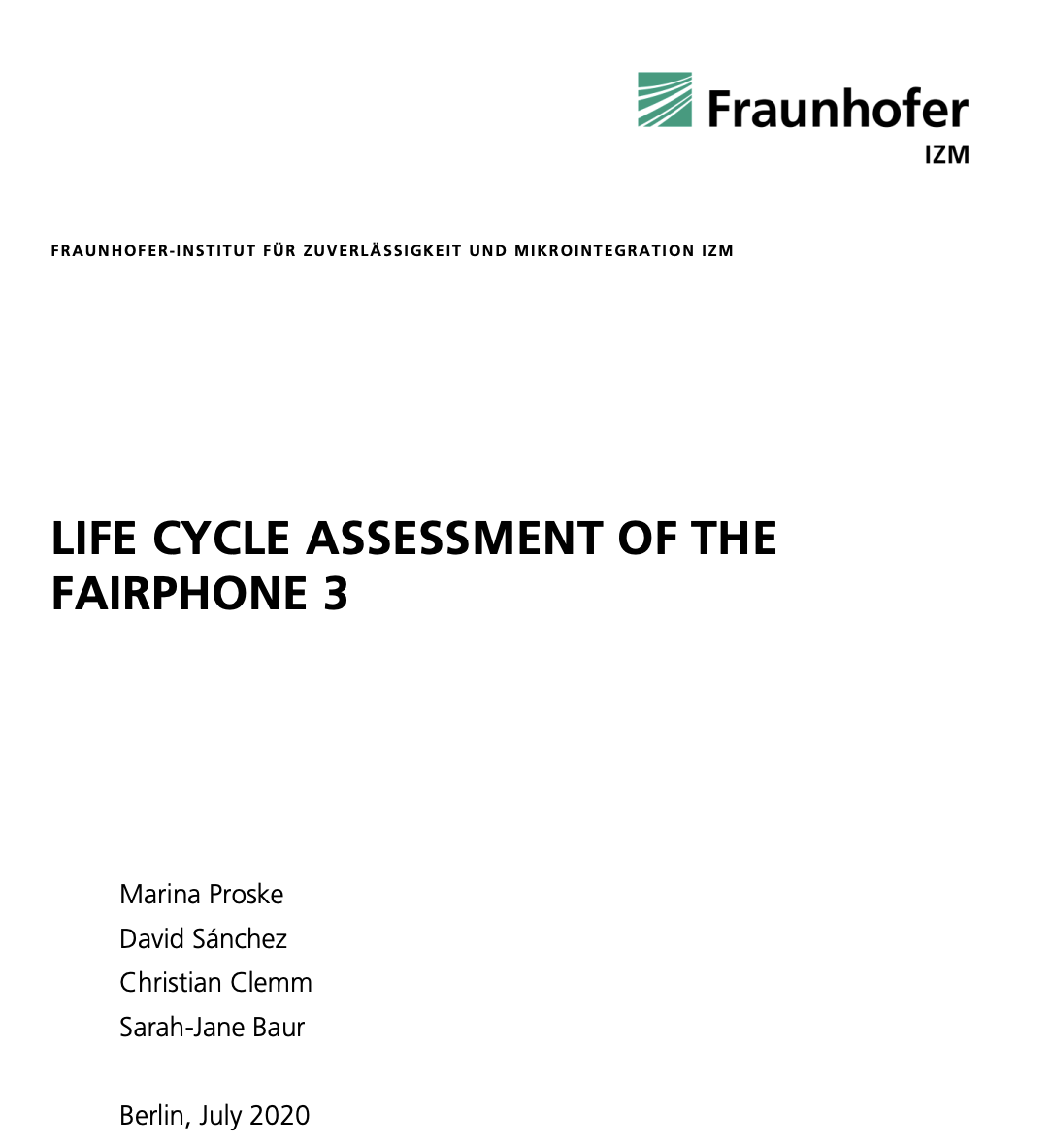
Estimating embodied footprint of Fairphone 3
https://www.fairphone.com/wp-content/uploads/2020/07/Fairphone_3_LCA.pdf
# Make sure you are in root directory
>$ cd ACT
>$ python3 tutorial/fairphone3_tutorial.py
--------------------------------
ACT RAM + Flash 0.0 kg CO2 vs. LCA 11 kg CO2
ACT CPU 0.0 kg CO2 vs. LCA 1.07 kg CO2
ACT ICs 0.0 kg CO2 vs. LCA 5.3 kg CO2
Full end to end example can be found here: https://github.com/S4AI-CornellTech/ACT/blob/main/exps/fairphone3/fairphone3.py

Slide 6
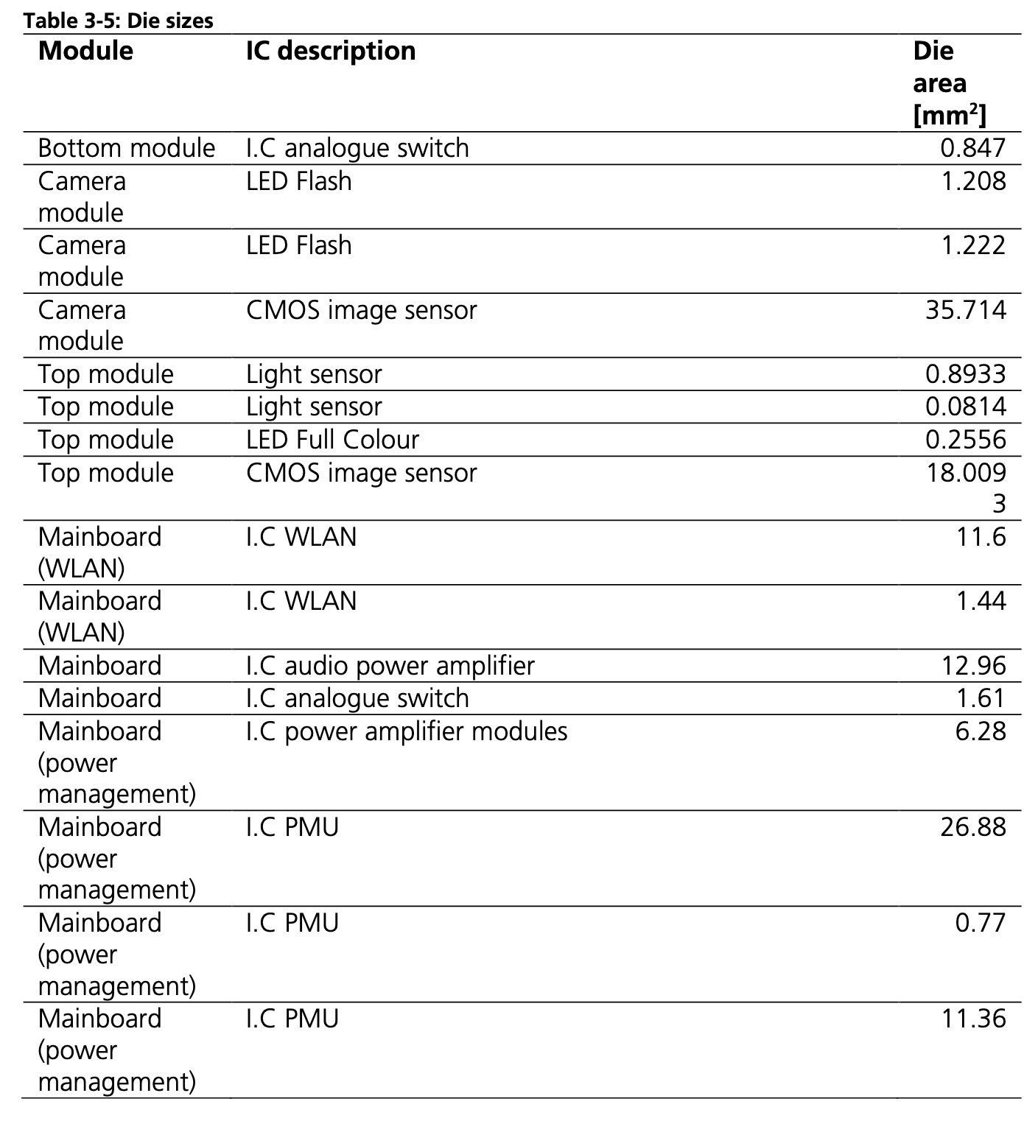
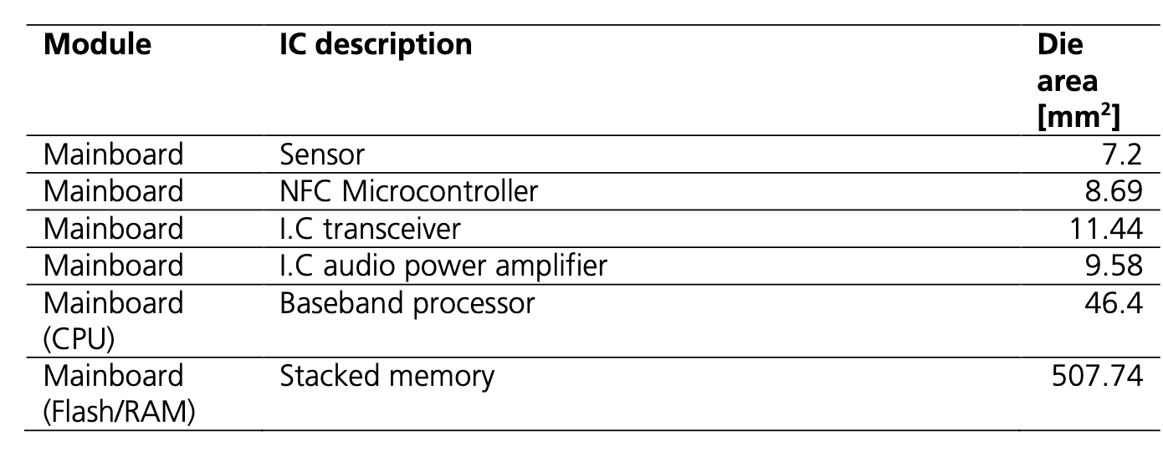
Finding die areas for ICs in the Fairphone 3
https://www.fairphone.com/wp-content/uploads/2020/07/Fairphone_3_LCA.pdf
# Main Fairphone integrated circuits' areas in mm^2
# https://www.fairphone.com/wp-content/uploads/2020/07/Fairphone_3_LCA.pdf
# Look at page 22 (Table 3-5)
fairphone3_IC_areas = []

Slide 7
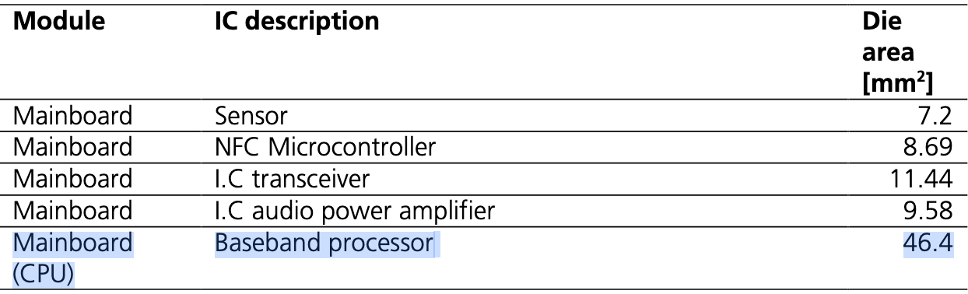
Specifying CPU, DRAM, SSD and Yield
https://www.fairphone.com/wp-content/uploads/2020/07/Fairphone_3_LCA.pdf
fairphone_cpu_area = 46.4 #mm^2
fairphone_ram = 4 # GB
fairphone_storage = 64 # GB
ic_yield = 0.875

Slide 8
Setting up ACT for IC Logic
IC_Logic = Fab_Logic(
gpa = "95",
carbon_intensity = "src_coal",
process_node = 28,
fab_yield=ic_yield)
gpa = {“95”, “99”}
carbon_intensity = {“src_{energy_source}”, “loc_{country}”}
process_node = {28, 20, 14, 10, 8, 7, 5, 3}
fab_yield = yield where 0 <= yield <= 1

Slide 9
Setting up ACT for CPU Logic
IC_Logic = Fab_Logic(
gpa = "95",
carbon_intensity = "src_coal",
process_node = 28,
fab_yield=ic_yield)
CPU_Logic = Fab_Logic(
gpa = "95",
carbon_intensity = "src_coal",
process_node = 28,
fab_yield=ic_yield)

Slide 10
Setting up ACT for DRAM and SSD
For all DRAM and SSD configs, see config files in /dram/ and /ssd/ folders
# DRAM Logic node
DRAM = Fab_DRAM(
config = "ddr3_50nm", fab_yield=ic_yield)
# SSD Logic node
SSD = Fab_SSD(
config = "nand_30nm", fab_yield=ic_yield)

Slide 11
Computing the IC Carbon Footprint
IC_Logic.set_area(sum(fairphone3_IC_areas)/100.)
# area in cm^2
CPU_Logic.set_area(fairphone_cpu_area/100.)
# area in cm^2
DRAM.set_capacity(fairphone_ram)
SSD.set_capacity(fairphone_storage)
packaging_intensity = 150 # gram CO2

Slide 12
Estimating embodied footprint of Fairphone 3
# Make sure you are in root directory
>$ cd ACT
>$ python3 tutorial/fairphone3_tutorial.py
--------------------------------
ACT RAM + Flash 5.310285714285714 kg CO2 vs. LCA 11 kg CO2
ACT CPU 0.8992937142857143 kg CO2 vs. LCA 1.07 kg CO2
ACT ICs 5.691643885714286 kg CO2 vs. LCA 5.3 kg CO2

Slide 13
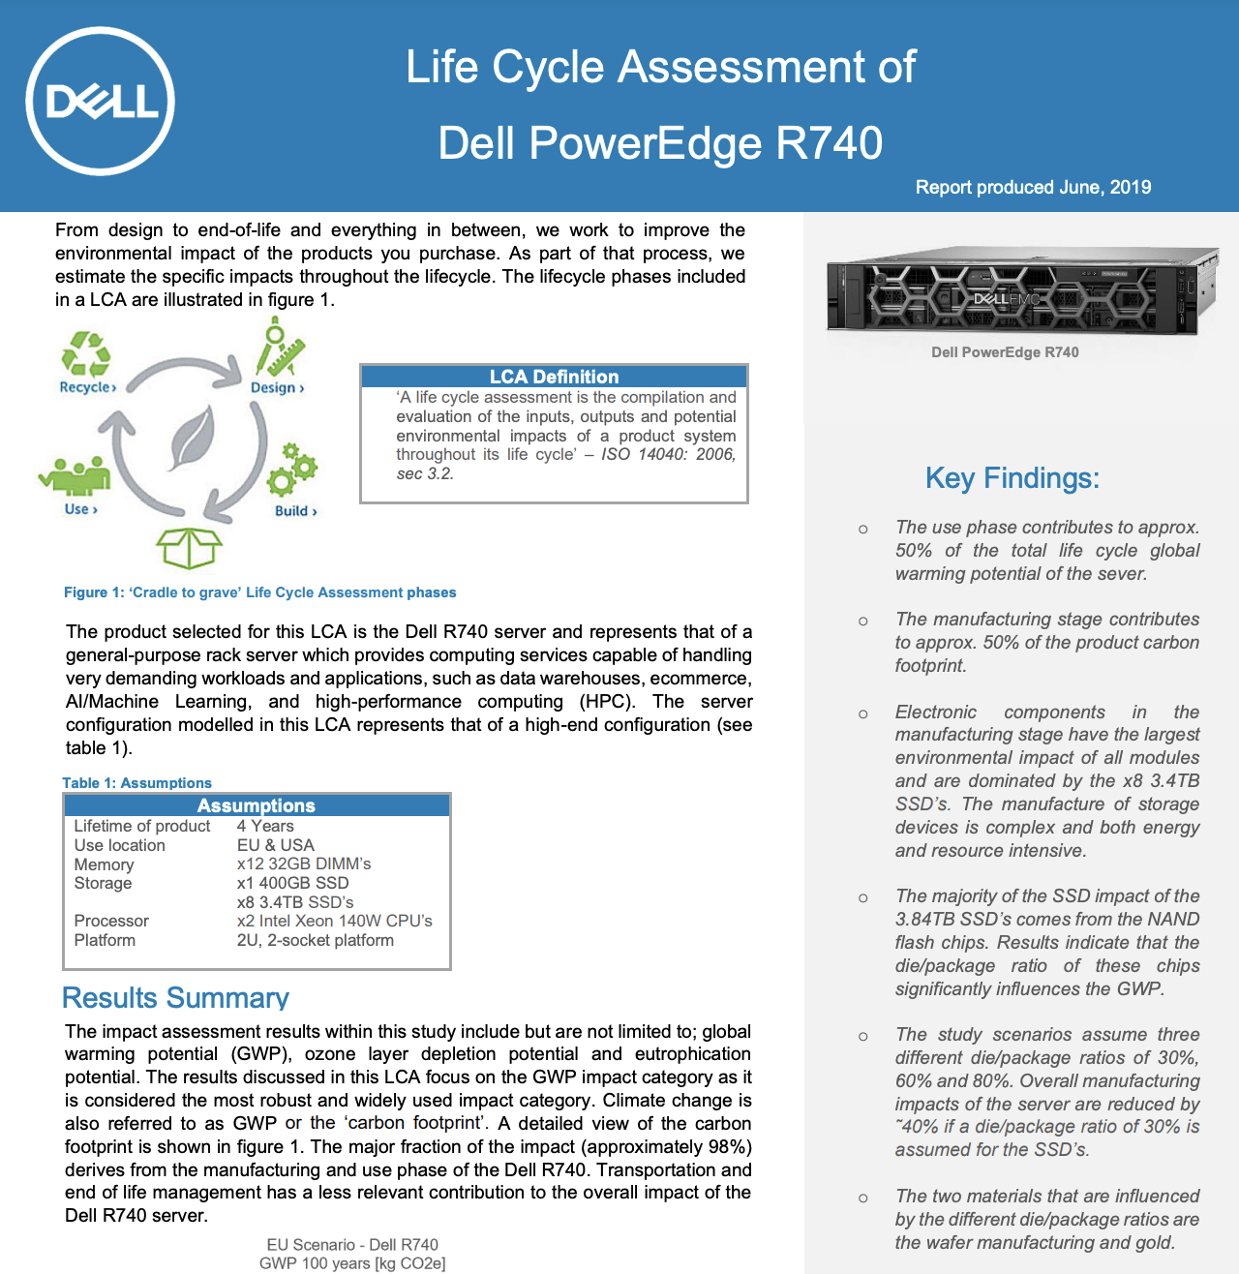
Estimating embodied footprint of Dell R740
https://corporate.delltechnologies.com/content/dam/digitalassets/active/en/unauth/data-sheets/products/servers/lca_poweredge_r740.pdf
# Make sure you are in root directory
>$ cd ACT
>$ python3 tutorial/dellr740_tutorial.py
--------------------------------
ACT SSD main 0 kg CO2 vs. LCA 3373 kg CO2
ACT SSD secondary 0 kg CO2 vs. LCA 64.1 kg CO2
ACT DRAM 0 kg CO2 vs. LCA 533 kg CO2
ACT CPU 0 kg CO2 vs. LCA 47 kg CO2
Full end to end example can be found here: https://github.com/S4AI-CornellTech /ACT/blob/main/exps/dellr740/dellr740.py

Slide 14
ACT Tutorial: Today
Time | Topic
1:00 – 1:15pm | Introductory remarks
1:15 – 1:30pm | Sustainable Computing: Motivation and Challenges
1:30 – 2:15pm | Overview of ACT: An Architectural Carbon Modeling Tool
2:15 – 2:45pm | Hands-on ACT demo
2:45 – 3:00pm | Extending ACT
3:00 – 3:30pm | Break
3:30 – 4:30pm | Invited Talks: Tools for Carbon Accounting
4:30 – 5:00pm | Discussion
5:00 – 5:05pm | Closing Remarks
Notes:
Finally, given our understanding of carbon emissions, we will conclude by charting paths for how to design future sustainable computing systems.

Slide 15
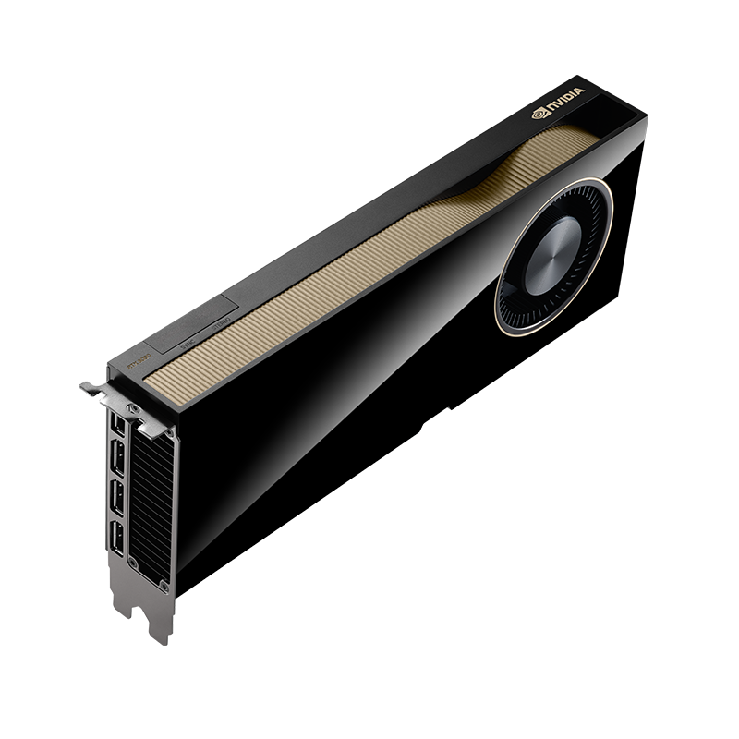
Estimating embodied footprint of GPUs
What if we do not have access to a component-level breakdown of the device?
# Make sure you are in root directory
>$ cd ACT
>$ python3 tutorial/a6000_tutorial.py
First-order carbon footprint estimates using existing LCAs
PDN = Fab_PDN(config = "lca_dellr740")
PCB = Fab_PCB(config = "lca_dellr740”)
PDN.set_power(a6000_power)
PCB.set_area(a6000_pcb_area/100.)
NVIDIA A6000

Slide 16
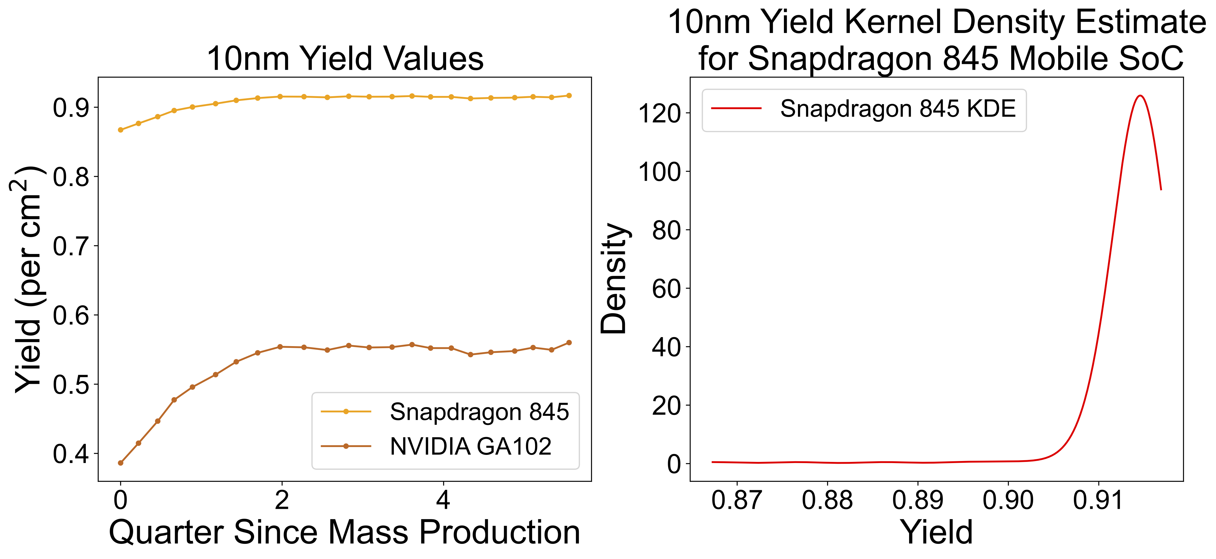
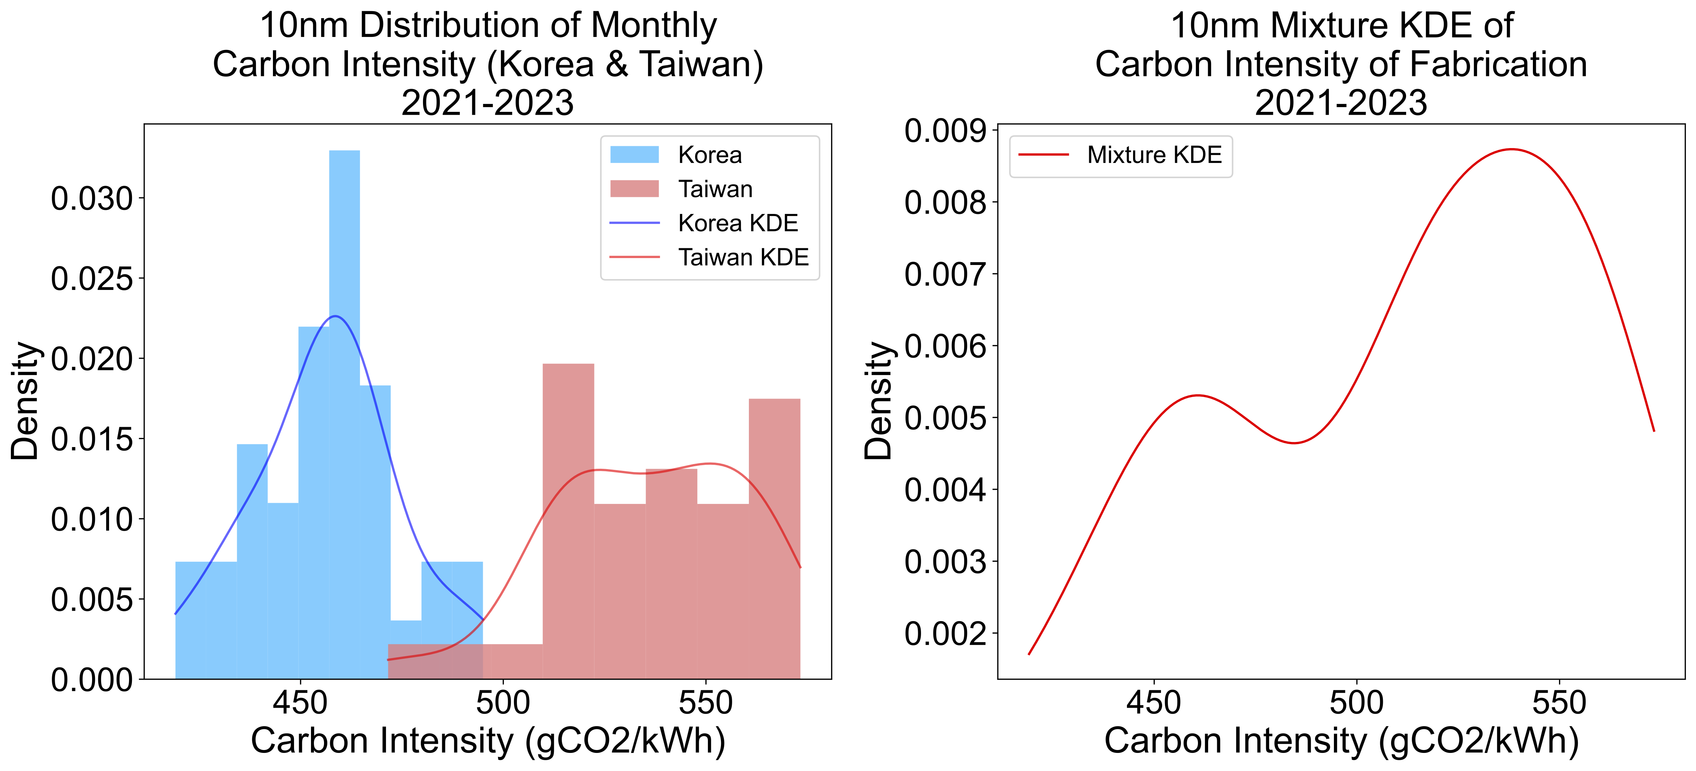
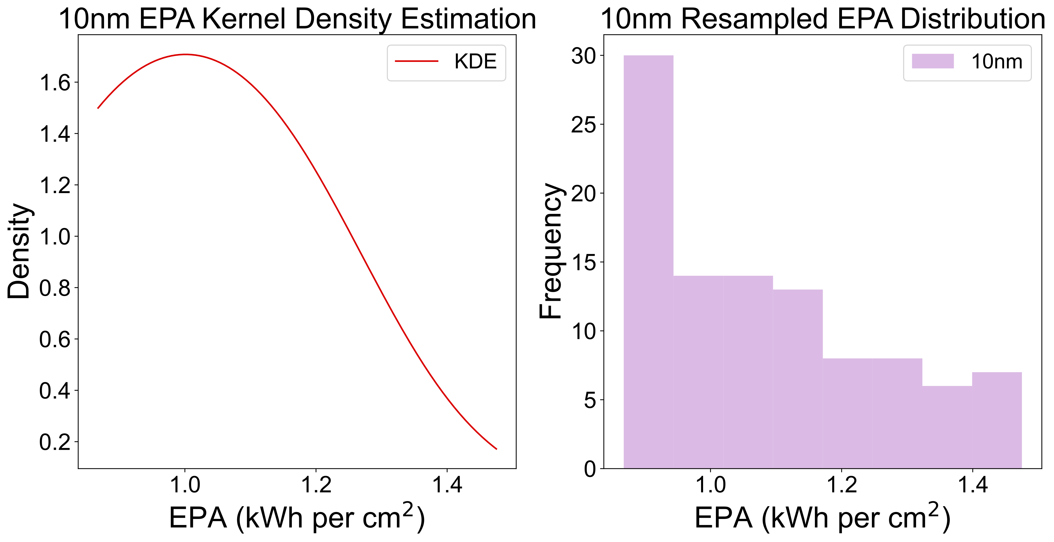
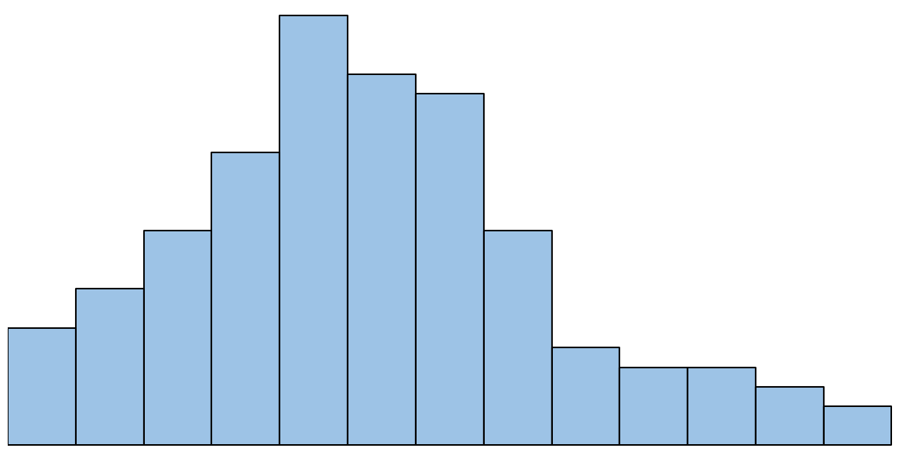
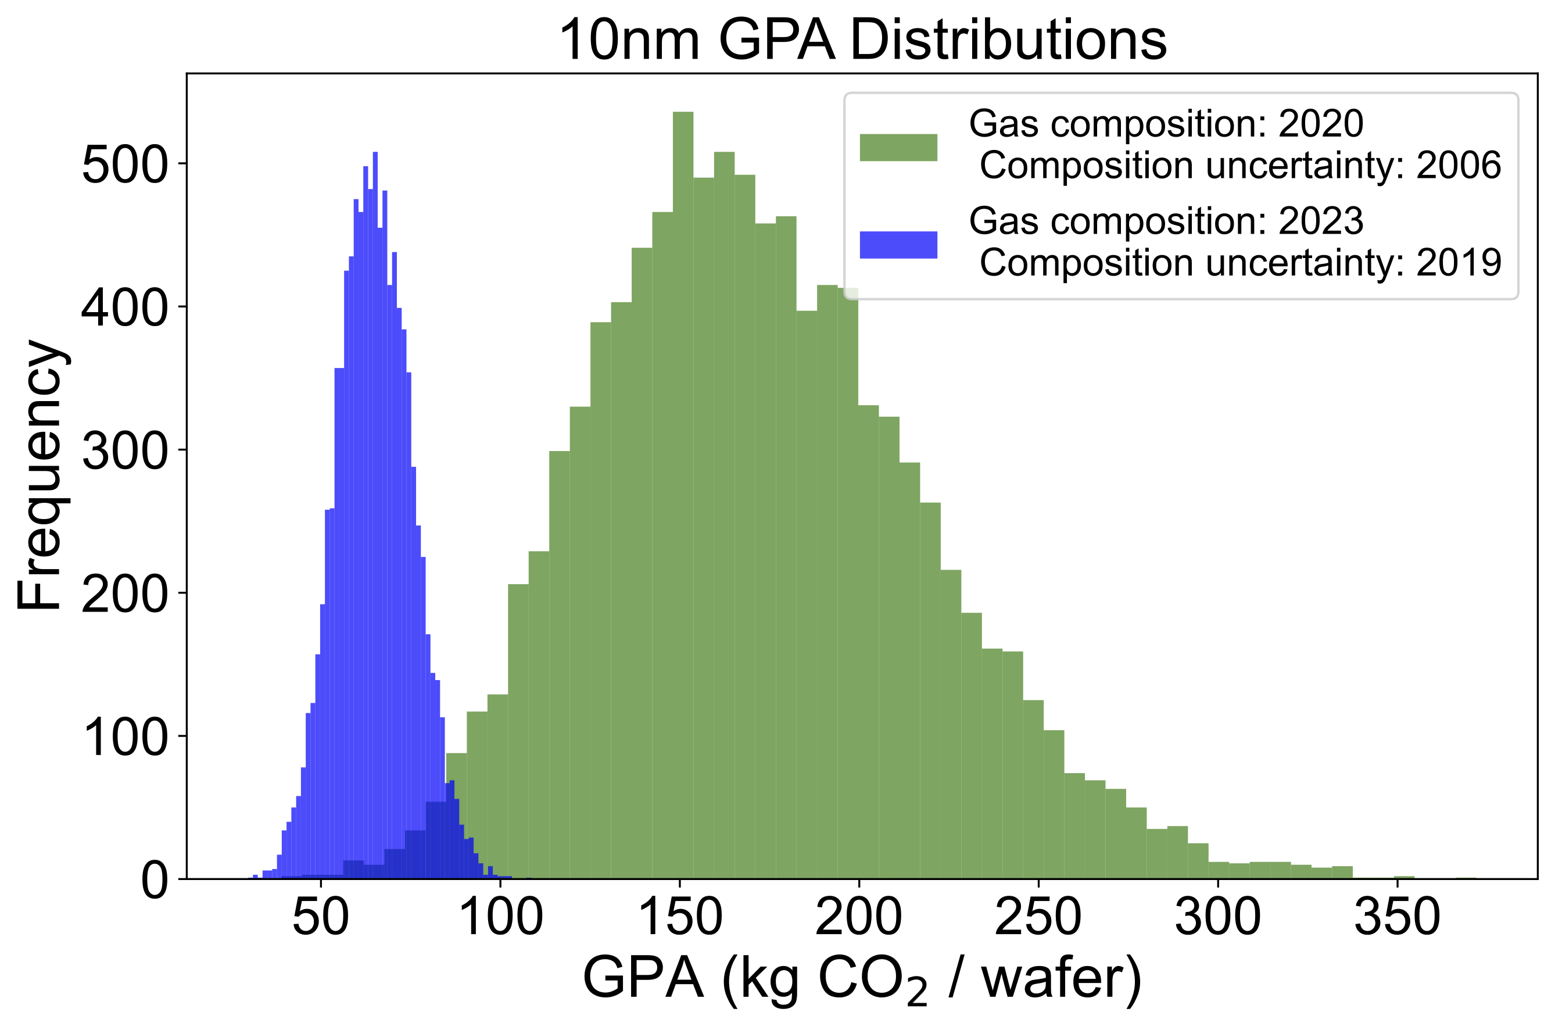
Modeling Input Uncertainties in ACT
4 cm²
Area
÷
Yield
CI_{fab}
×
×
E_{SoC}
EPA
+
GPA
+
500 gCO₂e/cm²
MPA
Anvita Bhagavathula, Leo Han, and Udit Gupta. Understanding the Implications of Uncertainty in Embodied Carbon Models for Sustainable Computing. Presented at HotCarbon’24.
Notes:
In summary, our probabilistic model allows for inputs to modeled as single values, synthetic distributions, or kernel density estimates. Samples are drawn from the input distribution; the samples are then used in the carbon model calculation to generate a histogram that approximates the probability distribution of the estimated carbon footprint.

Slide 17
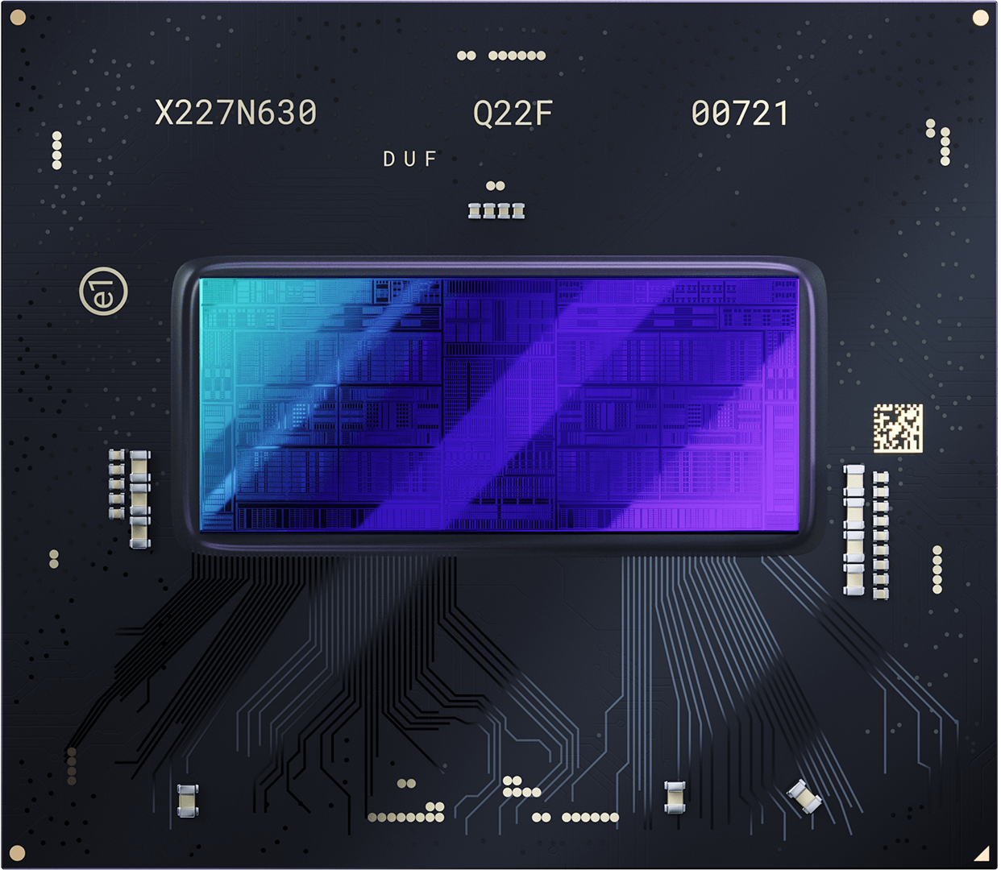
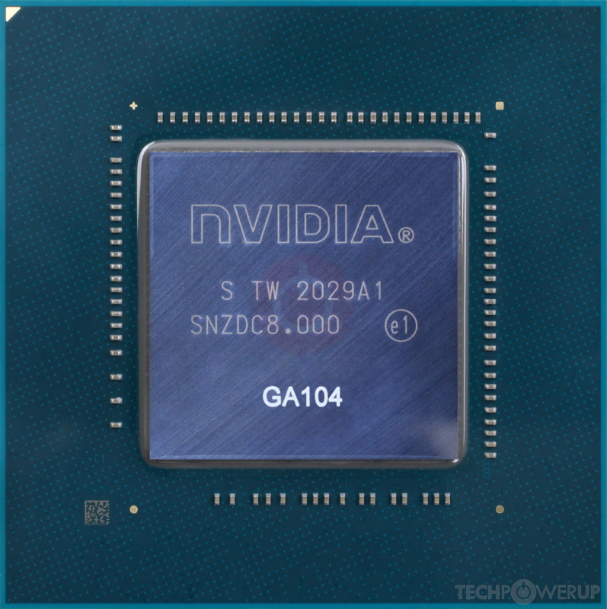
Case study: Notebook GPU selection
TSMC N6
4.06 cm²
60 W
Samsung 8N
3.92 cm²
70 W
Intel Arc Pro A60M
NVIDIA RTX A3000 Mobile
Notes:
To demonstrate our approach, we apply our probabilistic carbon modeling tool to a device selection case study. In this case study, we are a sustainable notebook or laptop manufacturer, and we want to select a carbon-optimal GPU for our new notebook computer. We are deciding between two GPUs of the same performance class: the Intel Arc Pro A60M and the NVIDIA RTX A3000 Mobile. We can see that they have different operating power, different manufacturing process nodes, and different chip areas.

Slide 18
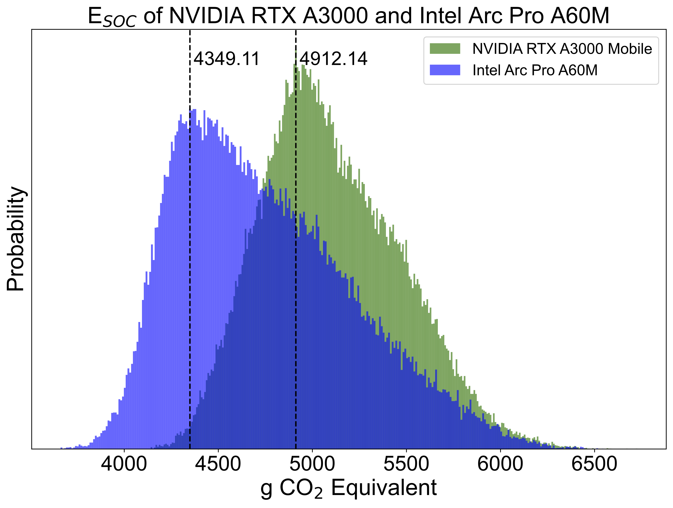
Intel Arc Pro A60M is better?
Likely, but not necessarily
27% chance
Intel Arc Pro A60M is worse
Notes:
We run these devices through our model and generate a probabilistic embodied carbon footprint estimate for each of devices. The vertical axis here is probability and the horizontal axis here is carbon footprint. If we just look at central tendency values such as the modal value, we would decide that the Intel Arc Pro A60M is better choice. This is the exact type of conclusion that a deterministic model that outputs a single value would tell you. However, with the probability distributions of the carbon footprint estimates, we see that the Intel Arc Pro A60M is likely to be better but not necessarily. In fact, there is a significant region of overlap in which the embodied carbon footprint of the NVIDIA GPU can be lower than the Intel GPU. Via our probabilistic modeling, we can determine that the chance of the NVIDIA GPU having lower embodied carbon is 27%, meaning that someone who uses a deterministic carbon model will be unaware that there is a 27% chance they will make the wrong decision.

Slide 19
ACT Tutorial: Today
Time | Topic
1:00 – 1:15pm | Introductory remarks
1:15 – 1:30pm | Sustainable Computing: Motivation and Challenges
1:30 – 2:15pm | Overview of ACT: An Architectural Carbon Modeling Tool
2:15 – 2:45pm | Hands-on ACT demo
2:45 – 3:00pm | Extending ACT
3:00 – 3:30pm | Break
3:30 – 4:30pm | Invited Talks: Tools for Carbon Accounting
4:30 – 5:00pm | Discussion
5:00 – 5:05pm | Closing Remarks
Notes:
Finally, given our understanding of carbon emissions, we will conclude by charting paths for how to design future sustainable computing systems.

